Slide 1

Submitted By:
SANKHA RAY, M.Tech (CSE),
Regn-15506024, 2nd Yr., SRMIST

Slide 2
ABSTRACT
To provide predictable transmission rate in a Bluetooth network.
To provide reliable MPEG Variable Bit Rate (VBR) video transmission without long delay and excessive data loss or image quality degradation.

Slide 3
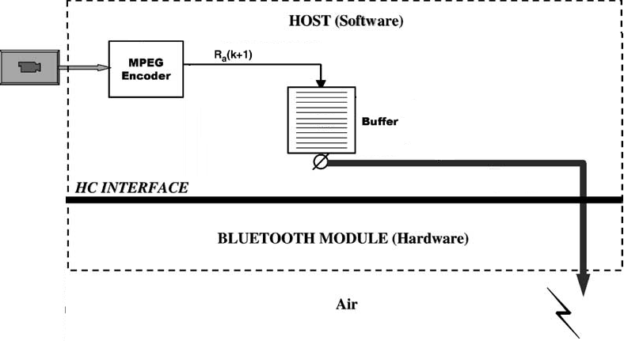
Architecture
Without Fuzzy Logic

Slide 4
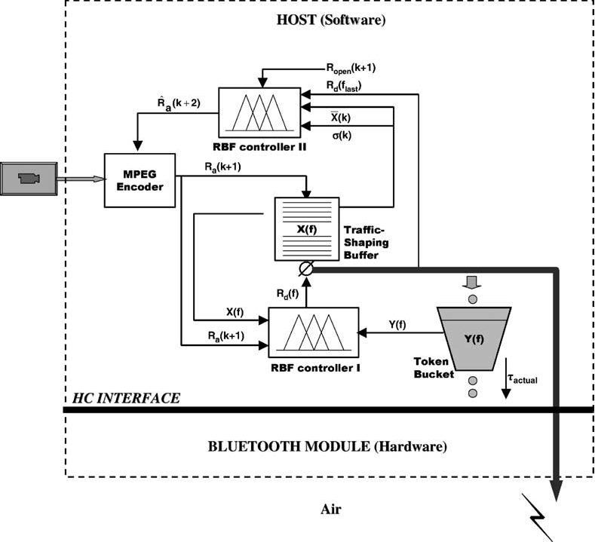
Architecture
Fuzzy Logic Implementation

Slide 5
Project Modules
MPEG Encoder
Traffic Shaping Buffer
Rule-based-fuzzy implementation
Neuro-Fuzzy implementation
Leaky Bucket(GCRA)

Slide 6
Overall Block Diagram
Neuro Fuzzy
MPEG Encoder
Traffic- Shaping Buffer
AVI Video
R_{a}
Rd(f)
X(k)
Σ(X)
RBF
Leaky Bucket (GCRA)

Slide 7


Slide 8
MPEG Encoder
AVI/MPEG video will be given to MPEG Encoder to encode/Zip the information before it is sent to Traffic-Shaping Buffer.
Java class is used to zip the MPEG video file to compress to its minimum size, suitable to transmit over bluetooth channel.
On the Other hand compressed video is decompressed to get the original one.
Image quality is not degraded in this compression.

Slide 9
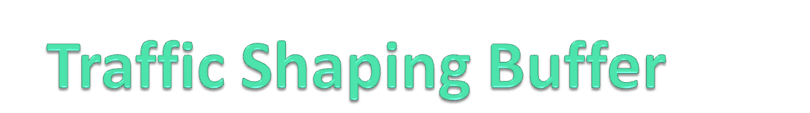
Advantages:
Control access to bandwidth when policy dictates that the average rate of a given interface should not exceed a certain rate.
Useful to Configure traffic shaping on an interface if network having differing access rates.
Buffers excess packets, therefore, less likely to drop excess packets.
Buffers packets up to the length of the queue. Drops may occur if excess traffic is sustained at a high rate.
Typically avoids retransmissions due to dropped packets.
Related to traffic shaping is flow specification, where a particular quality of service is agreed upon between sender, receiver and carrier.

Slide 10
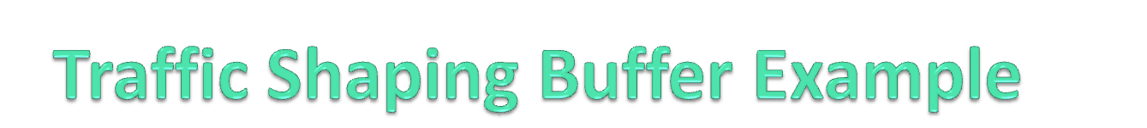
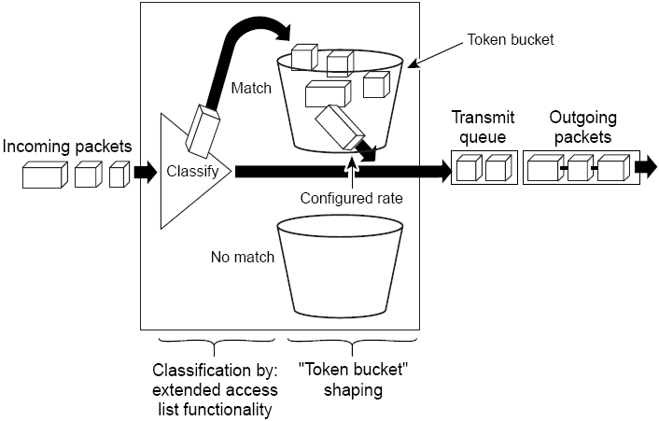
Generic Traffic Shaping

Slide 11
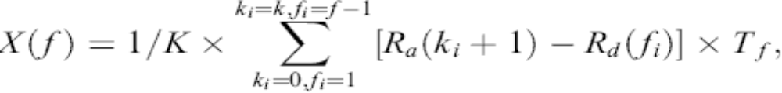
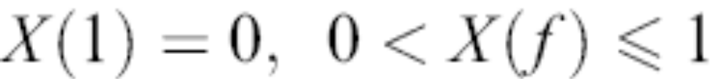
Formulas used
X(f) is calculated using the following Equation

Slide 12
Neuro-Fuzzy Implementation
This is an integrated controller which monitors the output rate or departure rate of the traffic-shaping buffer frame by frame to co-ordinate the video traffic entering Bluetooth.
The inputs to the NF controller are the queue length in the traffic-shaping buffer X(f) and the available memory space in the token-bucket Y(f).
The output from the NF controller is departure rate R_{d}(f), measured in kilobits per second.

Slide 13
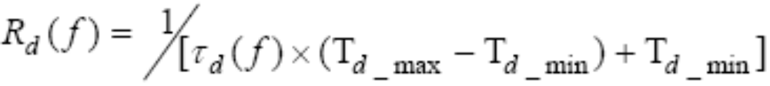
Formulas used
R_{d}(f) is calculated using Equation

Slide 14
Rule-based-fuzzy Implementation
This controller regulates the average arrival rate to the traffic-shaper to prevent either overflow or starvation of the buffer on a Group Of Picture (GOP) by GOP basis .
The inputs to the RBF controller are the mean X(f) and standard deviation Σ(X) of queue length in the traffic-shaping buffer.
The output from the RBF controller is the desired arrival rate .

Slide 15
Rules Used in RBF
If (token—Y(f) is empty) and (queue—X(f) is empty) then (output—i_{d} is very-large)
If (token—Y(f) is empty) and (queue— X(f) is medium) then (output—i_{d} is very-large)
If (token—Y(f) is empty) and (queue— X(f)is full) then (output—i_{d} is very-large)
If (token—Y(f) is empty) and (queue— X(f) is very-full) then (output—i_{d} is large)
If (token—Y(f) is medium) and (queue— X(f) is empty) then (output— i_{d} is very-large)
If (token—Y(f) is medium) and (queue— X(f) is medium) then (output— i_{d} is intermediate)
If (token—Y(f) is medium) and (queue— X(f) is full) then (output— i_{d} is small)
If (token—Y(f) is medium) and (queue— X(f) is very-full) then (output— i_{d} is very-small)
If (token—Y(f) is full) and (queue— X(f) is empty) then (output— i_{d} is very-large)
If (token—Y(f) is full) and (queue— X(f) is medium) then (output— i_{d} is small)
If (token—Y(f) is full) and (queue— X(f) is full) then (output— i_{d} is very-small)
If (token—Y(f) is full) and (queue— X(f) is very-full) then (output— i_{d} is very-small)

Slide 16
Leaky Bucket
Leaky Bucket Algorithm used to control rate in a datagram network. A single-server queue with constant service time. If bucket (buffer) overflows then packets are discarded.
Across a single link, only allow packets across at a constant rate.
Packets may be generated in a bursty manner, but after they pass through the leaky bucket, they enter the network evenly spaced.
If all inputs enforce a leaky bucket, its easy to reason about the total resource demand on the rest of the system.

Slide 17

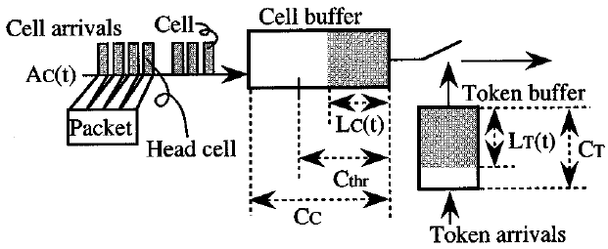
A packet-based Leaky-Bucket model

Slide 18
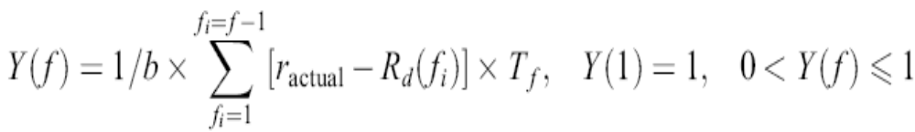
Formulas used
Y(f) is calculated using Equation

Slide 19
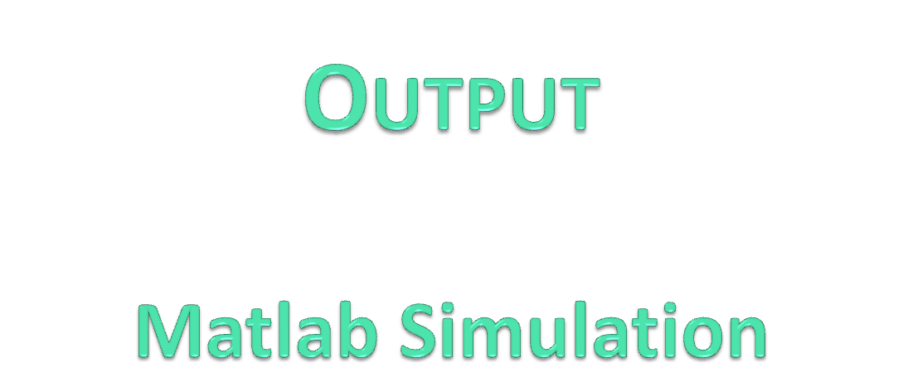

Slide 20
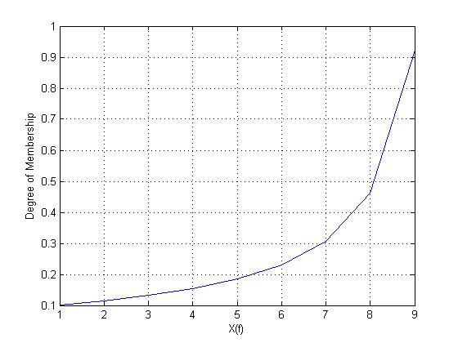
X(f):

Slide 21
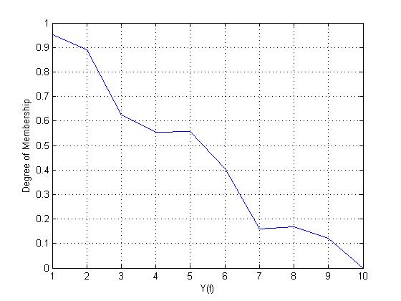
Y(f):

Slide 22
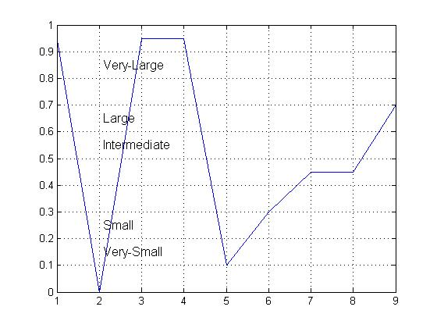
id(f):

Slide 23
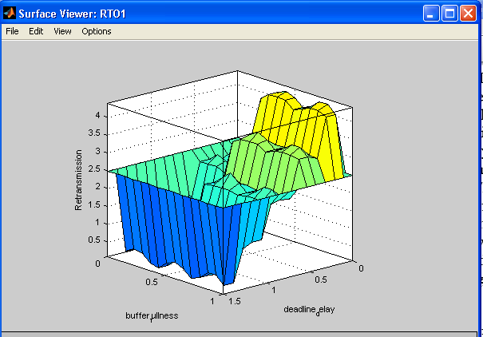
Retransmission Limit

Slide 24


